Slide 1
North Atlantic Commercial Fishing DSC 530
Final Project
Bret Young

Slide 2
Table of Contents
Introduction
Hypothesis
Variables
PMF
CDF
Normal Distribution
Area vs. Weight Comparison
Area vs. Species Comparison
Hypothesis Testing
Linear Regression Analysis
Summary
Resources

Slide 3
Introduction
Background
20 ICES countries submit Northeast Atlantic annual nominal catch statistics for over 200 species of fish and shellfish since 1904
Data used from 2006 thru 2017
2016 and 2017 are preliminary data
The data was not corrected for non-reported catches where such may have occurred

Slide 4
Hypothesis
Are certain species links to specific areas?
Help to identify location to fish when targeting a specific species for commercial harvesting
Does France prefer salmon from Norway over self caught?
Salmon is the most consumed fish in France
Article says Norway and Scotland provide a large portion of salmon to France
While the information does not provide when the fish are being consumed, it could indicate lower reported weights for France over Norway

Slide 5


Species
Three letter abbreviation for each species reported
Facts
Histogram of Species Counts
ASAIF_sp_2019.txt found in the GetHub resource has the coding for the fish species along with the scientific name and taxocode
Species_num was created to represent each species as a factor for graphing
Data hard to read, but we can see some species have much higher reported counts

Slide 6
Area
The areas where fish were caught divided up into smaller areas
Facts
Histogram of Area Count
Map of areas on next slide
Area_num was created to generate factors for each individual area
Highest area count is 27 (general area including all sub areas)
Other areas do have higher counts indicating more fish reported from them

Slide 7
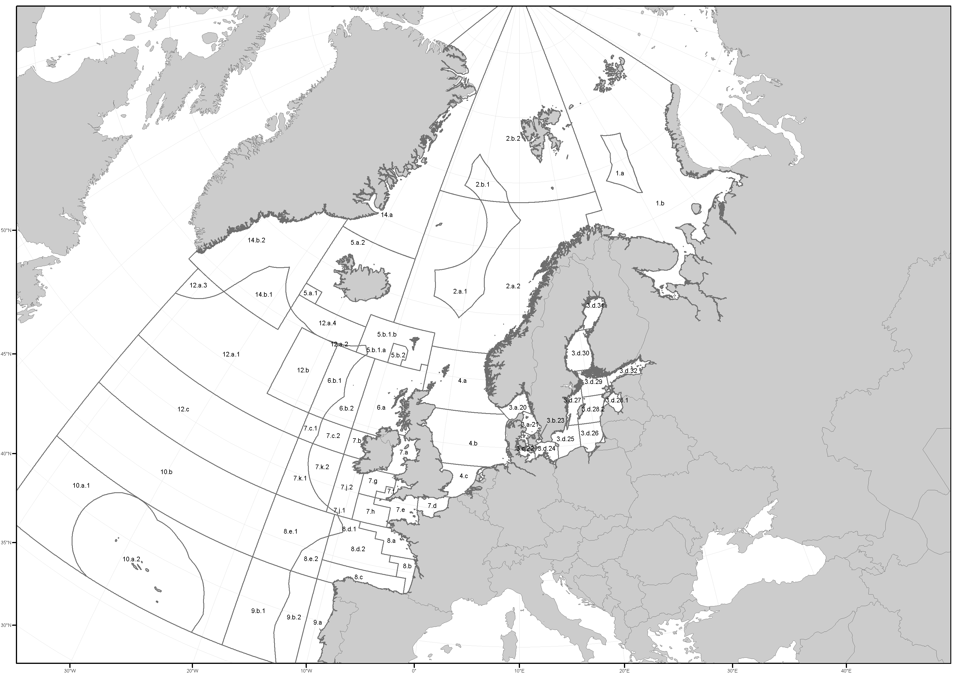
Area Map

Slide 8
Units
The units reported for the weights of species caught
Facts
All weights were reported in the same units (TLW)
This variable was not used because they were all the same

Slide 9
Country
Two letter abbreviation for the 20 countries in the ICES reporting group
Facts
Histogram of Country Count
Country codes can be found https://vocab.ices.dk/?ref=337
Most counts is Faroe Islands, followed by Estonia, Poland, then France
Norway is low on the list with less than 1000 counts
This doesn’t mean that they don’t report high numbers of fish, just that they don’t have as many areas or species reported

Slide 10
Weight (2006 - 2017)
Total weight reported for each country, area and species by year
Facts
Possible Fixes
There were many different reported weights for the species.
Creating a histogram did not produce any graph which could have been to do the large number of different values, the variable name being a number or something else
Create bins for the weights which should reduce the number of bins and allow for counts
This was the area where I encountered the first issue I was not able to overcome
I was able to create a list of the counts for each weight reported

Slide 11
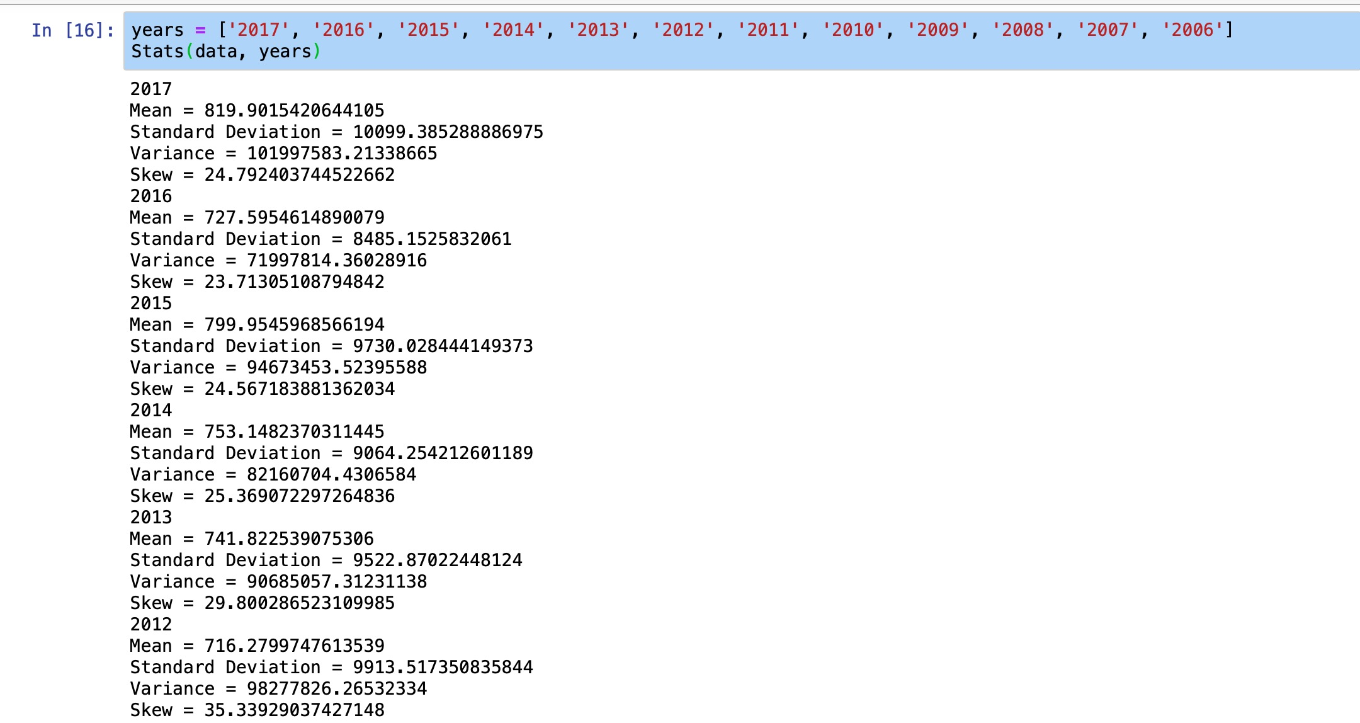
Summary Statistics for Weight

Slide 12
PMF
Species PMF for France 2017
This shows the probability of France reporting a species in 2017
Species PMF for Norway 2017
This shows the probability of Norway reporting a species in 2017

Slide 13
CDF
CDF of Species for France in 2017
This is based on the Species_num created variable
You can see there are some deviations in the data but it is almost a straight line
We will next look to see if this is a normal distribution

Slide 14
Normal Distribution
Normal or Not?
This is the plot of the Species for France in 2017 compared to a normal distribution
You can see that the plot is more sigmoidal rather than a straight line indicating that a normal distribution might not be the best representation of the data

Slide 15
Area vs. Weight
2017 Weight by Area_num
Here I factorized the Area to produce a continuous axis and plotted the weights reported for 2017 by the Area_num
There are a few areas that have higher reported weights indicating that more fish were collected from those areas
Covariance = -23719.12
Pearson's Correlation = -0.058
Spearman Correlation = -0.102

Slide 16
Area vs. Species
2017 Species_num by Area_num
Here I factorized the Area to produce a continuous axis and plotted the Species_num reported for 2017 by the Area_num
Here we can see lines of areas where the different species are reported being caught
Covariance = 198.40
Pearson's Correlation = 0.020
Spearman Correlation = 0.022

Slide 17
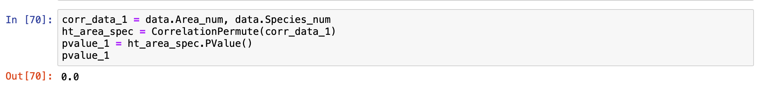
Hypothesis Testing
Null Hypothesis:
Area_num has no relation to Species_num
P-Value = 0.0
Null Hypothesis is rejected, there is a relationship between variables

Slide 18
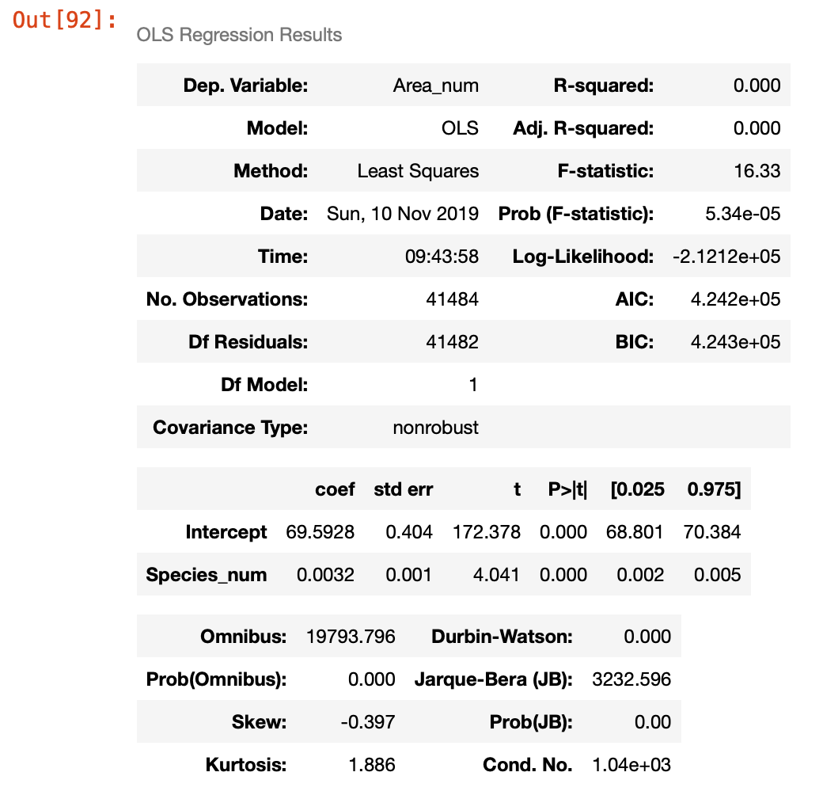
Linear Regression
Formula: 'Area_num ~ Species_num’
Equation: ‘Area_num = 0.0032*Species_num + 69.5928’
This equation should give us the best location to try and catch our target species

Slide 19
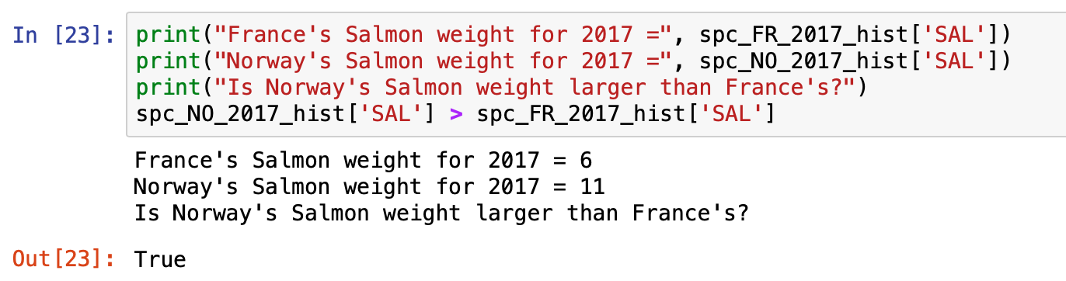
Summary
Does Norway report more salmon than France?
This means France prefers salmon form other sources other than self caught.
Sample Distribution
The distribution is sigmoidal in shape that is only represented by a normal distribution in the middle.
Where to fish for specific species?
Area_num = 0.0032*Species_num + 69.5928
This formula would provide the Area_num to fish for a Species based on Species_num

Slide 20
Future Work
Investigate data back to 1904 to see:
If harvesting has increased
Species have migrated areas
Obtain Consumption Data
See if France consumes more Salmon than they harvest
See if Norway consumes less Salmon than they harvest
Most consumed fish compared to harvest data

Slide 21
RESOURCES
PROJECT RESOURCES
Data Source - https://www.ices.dk/marine-data/dataset-collections/Pages/Fish-catch-and-stock-assessment.aspx
France salmon consumption link - https://salmonbusiness.com/norwegian-salmon-most-consumed-fish-in-france/
Think Stats Book - http://greenteapress.com/thinkstats2/html/index.html
Python Packages Utilized
thinkstats2
pandas
Numpy
Github Repository
https://github.com/youngb1801/DSC-530

